Slide 1
Lecture 2
An Introduction to MINFin
Open Learn Collection
Financial Modelling for Energy Transitions: MINFin, FinTrack & FinCoRE

Slide 2
Lecture Outline
Financial Modelling for Energy Transitions
 | Learning Objectives
Part 1 | Introducing MINFin’s Three Pillars
Part 2 | Introducing MINFin’s High-Level Dashboard
Part 3 | Kenya Case Study: Pillars
Part 4 | Kenya Case Study: Dashboard

Slide 3
Learning Outcomes
Understand the three pillars of the MINFin model and the basis on which they are derived.
Recognise how the three pillars interact in the High-Level Dashboard.
Follow a simple MINFin country case study.

Slide 4
Introducing MINFin’s Three Pillars
Part 1

Slide 5

A Simplified Representation of Model Structure
High-Level Dashboard
Provides MINFin with an iterative tool to develop a financing strategy
Investment Needs
The amount of investment needed each year to achieve the energy transition
Financing Requirement
The amount of capital needed each year to repay the investment needs at the terms of finance available to the country
Funding Availability
The amount of capital available in the sector to repay the financing requirement
Notes:
The MINFin model is built on three pillars.
Investment needs: This is the amount of investment needed each year to achieve energy transition.
Financing requirement: Due to the large scale of investments, these typically need to be financed to spread out the costs over time. The terms of finance will vary significantly depending on the type of country and the type of project. Financiers will need to be paid each year of the financing arrangement to gradually return the amount of capital that they have provided up-front plus a suitable rate of return on that capital. The financing requirement is the amount of money needed each year to repay the financiers of the energy transition plan.
Funding availability: Financiers will typically only provide finance if they can be sure that there is enough money available to repay them, when all other obligations have been taken into account. The funding availability is the amount of money that is available within the energy sector to repay the financing requirement, when all other obligations have been taken into account.
It may be helpful to use a simple illustration. Imagine that you are buying a house. Your financing need is the price of the house. Your financing requirement is the monthly mortgage payment on the house for the duration of the mortgage. Your funding availability is that portion of your income that is available for the repayment of the mortgage. The same concepts apply at the national level when countries seek to implement an energy transition investment plan.
Finally, each of the pillars is separately constructed by bringing external data and parameters into the MINFin model. When all three pillars of the model have been constructed, they are visually represented in the high-level dashboard. The high-level dashboard provides a graphical overview of the model results and also includes a simple user interface that allows key model parameters to be varied to explore how this will affect the financial evolution of the energy sector.

Slide 6

Investment needs
The Investment Need (IN) is the amount of capital needed each year of the transition to both allow the construction of New Infrastructure (NI) and to provide compensation for early Fossil Fuel Retirement (FFR) of old plant before the end of its life.
${IN}_{t}={NI}_{t}+{FFR}_{t}$
Note: All numbers are fictional and purely illustrative
Notes:
The starting point for the MINFin model is to input detailed Investment Needs (IN) year-on-year for the duration of the transition.
The first type of input is the investment in New Infrastructure that is required each year throughout the transition period to satisfy energy demand while also meeting decarbonization targets. This is represented by the black portion of the bar chart.
The second type of input is the financial compensation required for early Fossil Fuel Retirement (FFR) of old plants each year of the transition period. In order to meet decarbonization targets, it may be necessary to shutdown fossil fuel plants ahead of their useful life, at least for some countries, that are heavily reliant on fossil fuels and where fossil fuel plants are of relatively recent construction. This is represented by the grey portion of the bar chart.

Slide 7
Investment needs methodology
OSeMOSYS
Optimization model that meets projected energy demand at minimum system cost
Used to develop investment scenarios incorporating decarbonization targets
Estimates year-on-year investment needed in new renewable energy infrastructure
Estimates capacity of fossil fuel plants that need to be retired from the system year-on-year
FFRM
Optimization model that selects specific fossil fuel plants for early retirement in line with OSeMOSYS plan
Calculates financial amounts needed to compensate plant owners for early retirement
Considers both characteristics of plants as well as nature of contracting arrangements
Notes:
These two components of Investment Needs (IN) are calculated outside MINFin using other modelling tools. The output of these models becomes an input to MINFin and provides the basis for the sector financial analysis that will subsequently be undertaken. Two different types of model input are potentially relevant and can be used in conjunction with each other and with MINFin, both of which will be further explored in Lecture 3.
For the calculation of New Infrastructure (NI) investment needs a least cost planning model must be utilized. There are numerous least cost planning models in existence that can be used to generate the required investments in new clean energy infrastructure. However, MINFin is currently set-up to take detailed model outputs from the Open-Source Energy Modelling System (OSeMOSYS) developed by KTH and curated by CCG. Least cost planning models are designed to meet energy demand projections at minimum system cost but can be modified to incorporate policy targets for decarbonization via the incorporation of additional constraints. Any particular decarbonization target generates an investment scenario, and the MINFin model can accommodate more than one investment scenario, as will be discussed later.
For the calculation of financial compensation required for early Fossil Fuel Retirement (FFR) of old plants each year of the transition period additional steps are needed. Least cost planning models, such as OSeMOSYS will determine whether such early shutdown is necessary, and when it should occur, but will not consider the cost of financial compensation. However, early shutdown of plant is usually not possible without providing some form of financial compensation to the plant owners. The amount of compensation will depend on many factors, including the age and scale of the plant, as well as the contractual and financing arrangements under which it was originally built. However, broadly, it will be necessary to compensate for any unamortized debt and for profits legitimately anticipated by investors under the relevant contracts. Some tools exist to calculate the required compensation, notably the Fossil Fuel Retirement Model (FFRM) developed by the World Bank and curated by CCG.

Slide 8
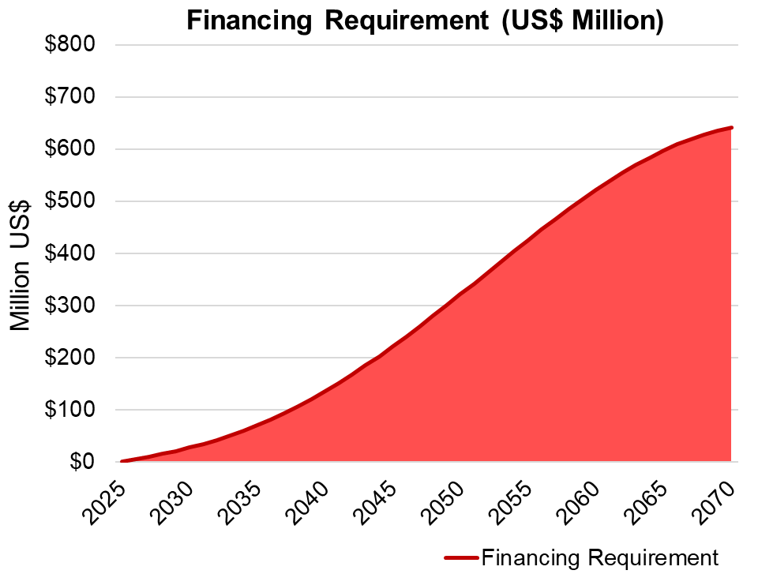

Financing requirement
The Financing Requirement (FR) is the future repayment of Investment Needs (IN) that will be required year-on-year throughout the transition period, based on anticipated financing terms (return (r), and period (p)) available to country
$${FR}_{t}=\frac{r(IN)}{1−{(1+r)}^{p}}$$
Note: All numbers are fictional and purely illustrative
Notes:
The MINFin model converts the Investment Need (IN) into a Financing Requirement (FR). Calculating the financing requirement entails taking the investment need established in the previous step, determining the financing terms that are likely to be available in the country, and using these to calculate the anticipated annual repayment for the financing. The two key components of the financing term are the return (r) required by financiers, and the period (p) over which the financing must be repaid. The annual financing requirements can then be represented in terms of a standard repayment formula as illustrated mathematically on the slide.
MINFin uses this approach to make the following calculations, which are then aggregated and displayed in the red line on the diagram. The red line on the graph illustrates, for a fictional case, how the financing requirements for a particular investment plan can be expected to accumulate over time.
Ongoing financing requirements for financial arrangements already contracted in the past are calculated and projected forward for the remainder of their respective financing terms. For example, if a country contracted a 20-year loan five years ago to finance the construction of a power plant, the remaining 15 years of loan repayment form part of the financing requirement.
New financing requirements for projects required to achieve energy transition are estimated based on likely financing terms determined through the historic financing baseline and/or forward-looking horizon scanning exercise. For example, if a country will need to take out a 30-year loan to build a new power plant in 10 years time, then the financing requirement for this plant will enter the calculations during the relevant time period.

Slide 9
Financing requirement methodology
Historic Financing Baseline
Compiles data on historic experience with energy project finance over last 5-10 years
Identifies all energy projects commissioned in reference period
Collect information on which financiers participated, and how much finance they provided of which type
Investigate the financing terms provided by each financier, including required return and financing period
Forward-Looking Horizon Scan
Explores willingness of financiers to provide finance for energy projects in future
Conducts survey of relevant national and international financiers
Ascertains likely volume of finance that could be provided under different scenarios
Investigates the financing terms each financier could be willing to provide under different scenarios
Notes:
Since future financing terms for new investment projects cannot be known with certainty in advance. MINFin requires users to explore two distinct and complementary approaches to estimating future financing terms.
Historic financing baseline. MINFin requires users to collect data on the historic experience with financing energy projects in the country over the last 5-10 years, This financing baseline provides a reference point in terms of what financing volumes and financing terms have been feasible to secure in the past. Constructing a historic financing baseline involves the following steps (to be further developed in Lectures 4-8). Research all the energy projects that have been constructed during the historic reference period, Ascertain the composition of finance (which financiers participated in the finance of the project, how much finance they provided, and what type of finance they provided). Investigate the terms of finance (what was the return demanded by financiers, what was the period of the finance)
Forward-looking horizon scan. The financing volumes and terms collected for MINFin can also be informed by a forward-looking horizon-scanning exercise. This entails surveying relevant national and international financial institutions that could participate in a country’s energy transition and eliciting their views on willingness to finance future energy transition projects in country, as well as the likely terms on which such financing could be provided.
These two sources of information can be combined to inform assumptions regarding future financing sources, volumes and terms, which are then used to calculate the future Financing Requirement (FR).

Slide 10

Funding availability
The Funding Availability (FA) is the future annual cashflow available to repay the Financing Requirement (FR), which is the sum of International Grants (IG), Government Expenditure (G), Internal Cash Generation (ICG), Fossil Fuel Expenditure Savings (FFS), and Carbon Credit Revenues (CC).
$${FA}_{t}={IG}_{t}+G_{t}+{ICG}_{t}+{FFS}_{t}+{CC}_{t}$$
Note: All numbers are fictional and purely illustrative
Notes:
The MINFin model allows the user to estimate the evolution of Funding Availability (FA) year-on-year throughout the transition period to repay the Financing Requirement (FR). This is done by adding together the main sources of funding typically available to the energy sector as follows.
International Grants (IG). These are grants provided by the international community for the energy transition, typically through development finance (World Bank, African Development Bank) or climate finance (Green Climate Fund, Global Environment Facility) channels. It is possible to estimate the value of future international grants based on historical trends, and a horizon-scanning of available grant finance windows.
Government Expenditure (G). This is the amount of public expenditure that is allocated to the energy sector through the government’s annual budget, which is typically sourced from a combination of tax revenues and government borrowing. It is made available to the energy sector without any expectation of repayment, either in the form of a capital or operating subsidy. It is possible to estimate future government expenditure based on historic budgetary trends and an analysis of how energy transition plans will affect the government budget.
Internal Cash Generation (ICG). This is the cashflow that is available from utility service providers operating in the energy sector to repay financing required for new energy projects, once all other financial obligations have been accounted for. It is possible to estimate this cashflow based on utility financial statements and associated future financial projections.
Fossil Fuel Expenditure Savings (FFS). This is the amount of money that will be saved as a country’s energy sector switches from fossil-based to renewables-based power generation, due to the fact that it will no longer be necessary to purchase fossil fuels for plant operation. It is possible to calculate such savings using a least cost planning model such as OSeMOSYS.
Carbon Credit Revenues (CC). This is the amount of revenue that could potentially be obtained from sale of carbon credits as a result of the reduction in carbon emissions associated with the energy transition. It is equal to the carbon savings estimated by a least cost planning model such as OSeMOSYS, multiplied by the anticipated price for carbon credits.

Slide 11
Introducing MINFin’s Dashboard
Part 2

Slide 12
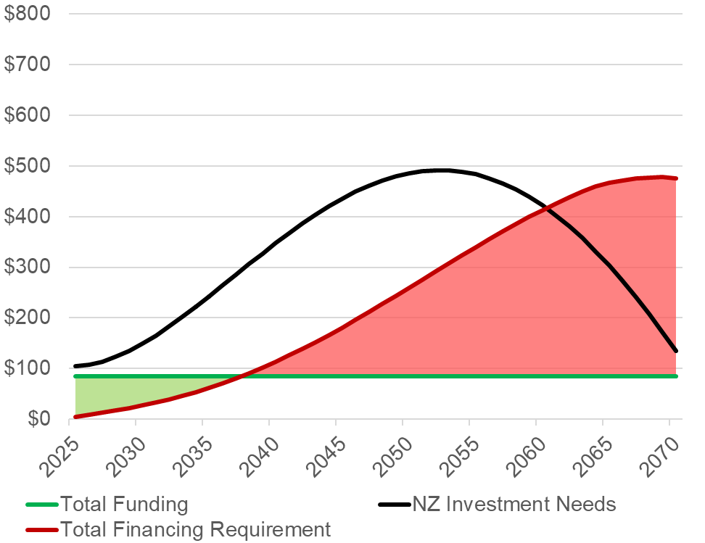
High level dashboard – business as usual
 | Future | Historic
Financing Requirements
Average Interest Rate | 7% | 7%
Average Term of Loan | 13 | 13
Funding Availability
CAGR of Government Spending | 0% | 0%
CAGR of SOE Internal Revenue | 0% | 0%
CAGR of Fossil Fuel Savings | 0% | 0%
CAGR of International Grants | 0% | 0%
Affordable
Financing Gap
(Unaffordable)
Note: All numbers are fictional and purely illustrative
Notes:
MINFin’s High Level Dashboard brings the three pillars of the model together in a simple visual framework:.
Investment Needs are shown in black. For a net zero energy transition by 2050, we would expect to see investment needs surge towards the date of the deadline and subside subsequently.
Financing Requirements are shown in red. The financing requirement typically lags and somewhat flattens the Investment Needs line, as it spreads the costs of those investments over time. Nevertheless, year-on-year investment needs will have a cumulative effect on the financing requirement.
Funding Availability is shown in green. The evolution of the funding availability is typically upwards as economic growth could be expected to increase some of the underlying cashflows.
The table shown next to the chart is the control panel that displays the key parameters that are determining the evolution of the Financing Requirements and the Funding Availability. In this fictional example, it has been assumed that the future evolution of these variables will follow historic trends, and hence the numbers displayed in the future and historic columns are identical. This is the default assumption.
Financing Requirements reflect the Weighted Average Cost of Capital for the country, which are summarized in this table by an average interest rate of 7% and an average term of loan of 13 years.
Funding Availability is projected based on the Compound Annual Growth Rate of the historic trends, which are summarized in the table as 0%, indicating that new future growth is anticipated based on recent history.
Finally, if the Financing Requirement (red line) breaches the Funding Availability (green line), as takes place in the example around the year 2030, this means that the country no longer has enough cashflows to cover repayment of financiers and there is a Financing Gap making the energy transition unaffordable, as in this case.

Slide 13
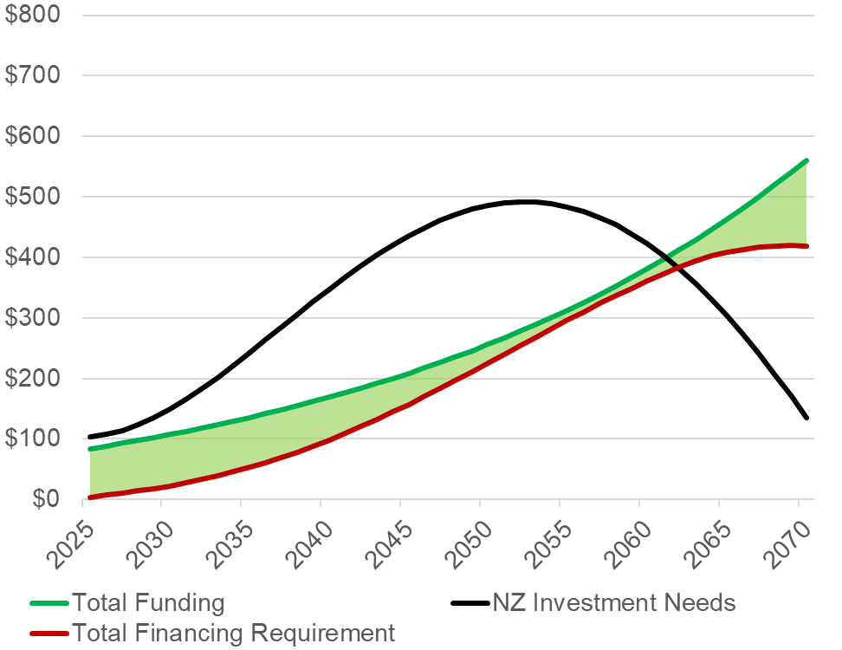
High level dashboard – alternative simulation
 | Future | Historic
Financing Requirements
Average Interest Rate | 4% | 7%
Average Term of Loan | 25 | 13
Funding Availability
CAGR of Government Spending | 4% | 0%
CAGR of SOE Internal Revenue | 4% | 0%
CAGR of Fossil Fuel Savings | 4% | 0%
CAGR of International Grants | 4% | 0%
Affordable
Note: All numbers are fictional and purely illustrative
Notes:
The High Level Dashboard can be used to simulate alternative futures, by allowing the parameters that underpin the financing scenario to diverge from historical experience. In this fictional example, the user has modified the parameters in the yellow highlighted future column of the table.
Financing Requirement: The terms of finance have been softened, with the average interest rate falling from 7% to 4% and the average loan term extending from 13 to 25 years. This has the effect of reducing the annual financing requirement for the given investment needs, shifting the red line downwards visibly compared to the previous chart.
Funding Availability: The compound annual growth rate of the various cashflows has been increased from 0% to 5% for government spending and international grants and 10% for internation cash generation and fossil fuel savings. This has the effect of increasing the funding availability, which leads to an upward shift of the green line compared to the previous chart.
As a result of these changes, the financing requirement represented by the red line, no longer breaches the funding availability represented by the green line, and the energy transition has become entirely affordable. This is just an example of how the MINFin framework can be used to simulate alternative financing futures, and look for financing conditions that will restore the financial equilibrium of the sector in the context of the energy transition.

Slide 14
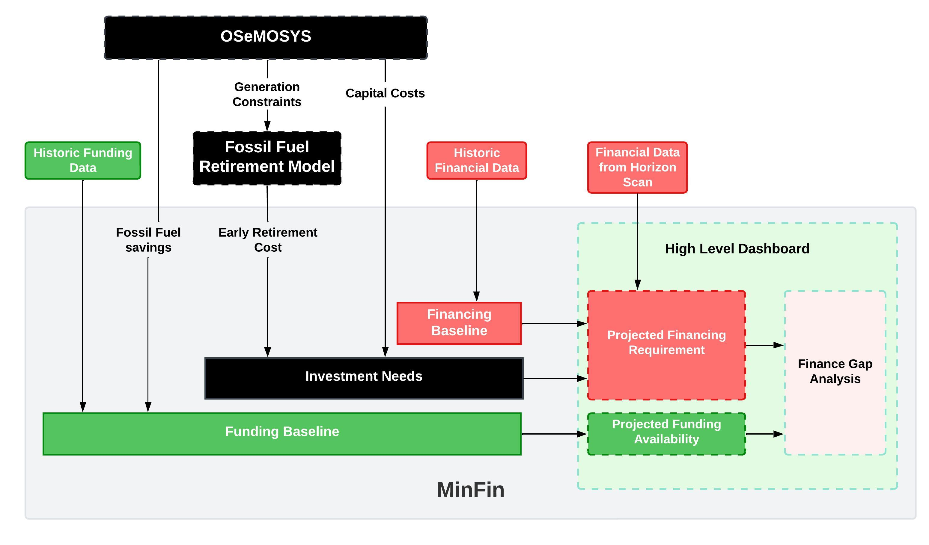
More complex representation of model structure
Notes:
Finally, we are now in a position to share a more detailed representation of how the different components of MINFin fit together. In this diagram, the large light grey shaded box represents what takes place inside the MINFin model, while other elements represent the inputs that need to be brought from the outside. Starting from the far right of the diagram and working backwards towards the left, we can explain the relationships as follows.
The High-Level Dashboard shown on the far right represents the projection of the Financing Requirement and Funding Availability throughout the duration of the transition, illustrating whether or not these two elements are in balance and the transition is affordable.
The projected Funding Availability draws upon the funding baseline that collects data on historic funding trends, and on the least cost planning model, OSeMOSYS, which calculates fossil fuel expenditure savings and carbon savings associated with the energy transition.
The projected Financing Requirement combines together the Investment Needs that determine the volume of financing needed, and the financing baseline that provides the anticipated terms of that finance.
The Investment Needs in turn draws upon the least cost planning model, OSeMOSYS, that estimates the investment needed for new renewable energy projects and determines the need for early retirement of fossil fuel plant, plus the Fossil Fuel Retirement Model, FFRM that calculates the financial compensation that this will necessitate.
The financing baseline draws upon both the historic financing trends in the country as well as potentially also a forward-looking horizon scan of future financing sources and terms.
Each of these components will be developed in much greater detail in subsequent lectures.

Slide 15
Kenya Case study:
Pillars
Part 3

Slide 16

Investment needs based on OSeMOSYS
Notes:
The figure shows Kenya’s Investment Needs to meet the country’s forecast energy demand, while at the same time dellivering a net zero energy transition by 2050. This estimate of investment needs is produced using the least cost planning model OSeMOSYS, which projects a fourfold surge of energy investment needs from under US$1,000 mission in 2025 to over US$4,000 million by the target net zero year of 2050. The bulk of the investments needed are in geothermal and onshore wind generation projects and distribution infrastructure.

Slide 17
Financing terms based on historic financing baseline
Sources of debt finance | Concessional International | Concessional Domestic | Commercial Domestic | Commercial International | Overall
Average Interest Rate (%) | 2.7% | 2.5% | 13.0% | 9.0% | 3.1%
Average Grace Period (years) | 6.2 | 5.9 | 5.8 | 2.3 | 6.0
Average Term of Loan (years) | 24.9 | 17.9 | 17.5 | 15.5 | 24.1
Average Grant Element (%) | 53.9% | 46.2% | 10.5% | 3.2% | 50.6%
Total Financing Volume (US$M/yr) | $573.9 | $14.7 | $3.7 | $34.6 | $626.9
Notes:
In order to determine the financing terms that would be used to calculate the Financing Requirement, a historic financing baseline exercise was conducted for Kenya. This entailed identifying all the energy projects that Kenya had constructed during the last decade and determining for each project the volumes of finance provided by different financiers, as well as the associated financing terms.
The overall results are summarized in the table averaging across four major categories of financiers. In total, Kenya has captured an average of US$627 million of finance for energy projects each year over the last decade - much less than what will be required during the future energy transition.
Concessional international finance. This is the international currency finance provided by bilateral and multilateral development finance agencies typically at rates significantly below the market. Historically, Kenya has relied predominantly on this source of finance for financing energy projects. International concessional financiers are willing to provide relatively large volumes of finance for Kenya, at the highly concessional interest rate of 2.7% with a generous repayment period of almost 25 years.
Concessional domestic finance. This is the finance provided by the national government or related state institutions, such as national development banks. Due to sovereign guarantees, the national government may be able to access capital at more attractive rates than the domestic private sector. Historically, the Kenyan government has provided very little finance to the energy sector, but when it has done so it has provided terms relatively close to those provided by international concessional finance, with an interest rate of 2.5% and a term of almost 18 years.
Commercial domestic finance. This is the finance provided by national commercial banks in local currency. Historically, Kenya’s domestic commercial banks have contributed almost nothing to the finance of energy projects. When they have done so, the interest rate has been very high in comparison with other sources of finance at 13%, while the term of loans has been relatively long approaching 18 years.
Commercial international finance. This is the finance provided by international commercial banks in foreign currencies, typically US dollars, or Euros, or Yuan. Historically, Kenya has accessed relatively modest amounts of international commercial finance. Interest rates have been relatively high at 9%, while terms have been relatively long at over 15 years on average.

Slide 18
Funding availability historic baseline
Notes:
A historic baseline exercise was conducted for Kenya’s funding availability, as a basis for future projection, identifying three major sources of funding:
Government spending. In Kenya, government spending on energy has been relatively low at around US$200 million a year, and on a declining trend towards levels of US$100 million a year by the mid-2020s. It is therefore not expected to be a major source of funding going forward.
Internal cash generation. In Kenya, utility internal cash generation has been by far the largest source of funding for energy projects, particularly in recent years. Internal cash generation increased substantially between 2010 and 2016 and has remained steady thereafter.
International grants. Kenya has received only very tiny amounts of international grants and only in certain years.
Other sources of funding were not considered relevant to Kenya. Since Kenya already has a heavily renewables-based power system, there are no significant fossil fuel expenditure savings resulting from the energy transition, nor any significant carbon savings that could be monetised through carbon credits.
Historically, funding availability in Kenya from all sources has averaged around US$600 million.

Slide 19
Kenya case study: Dashboard
Part 4

Slide 20
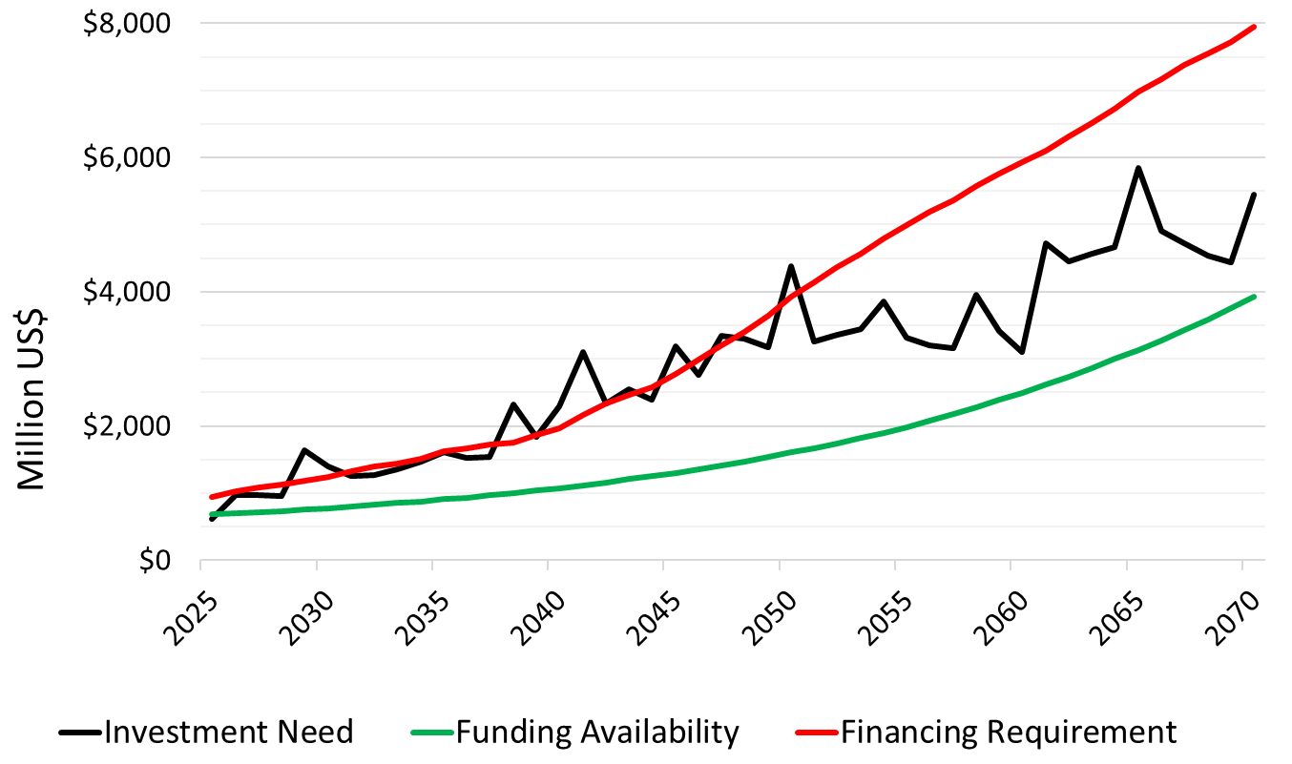
High-level dashboard under business-as-usual
MINFin Projections
Historic Baseline
Average interest rate (%) | 5.5%
Average Grace Period (years) | 4.6
Average Loan Term (years) | 25.6
CAGR govt spending | -2.6%
CAGR internal cash generation | 4.6%
CAGR int’l grants | -6.1%
Notes:
The high-level dashboard for Kenya illustrates that under business-as-usual conditions – in which historic trends and financing terms continue into the future – Kenya will not be able to afford the energy transition. Business-as-usual conditions include a relatively attractive weighted average interest rate of 5.5% with a weighted average loan term of over 25 years, as well as significant growth of 4.6% annually in international cash generation from utilities even as government spending and international grants continue to fall. Nevertheless, under these conditions, the financing requirement (red line) lies above the funding availability (green line) for the entire transition period indicating that the transition is unaffordable. The associated financing gap is minimal in the early years, but opens-up significantly by 2040 getting larger and larger over time.

Slide 21
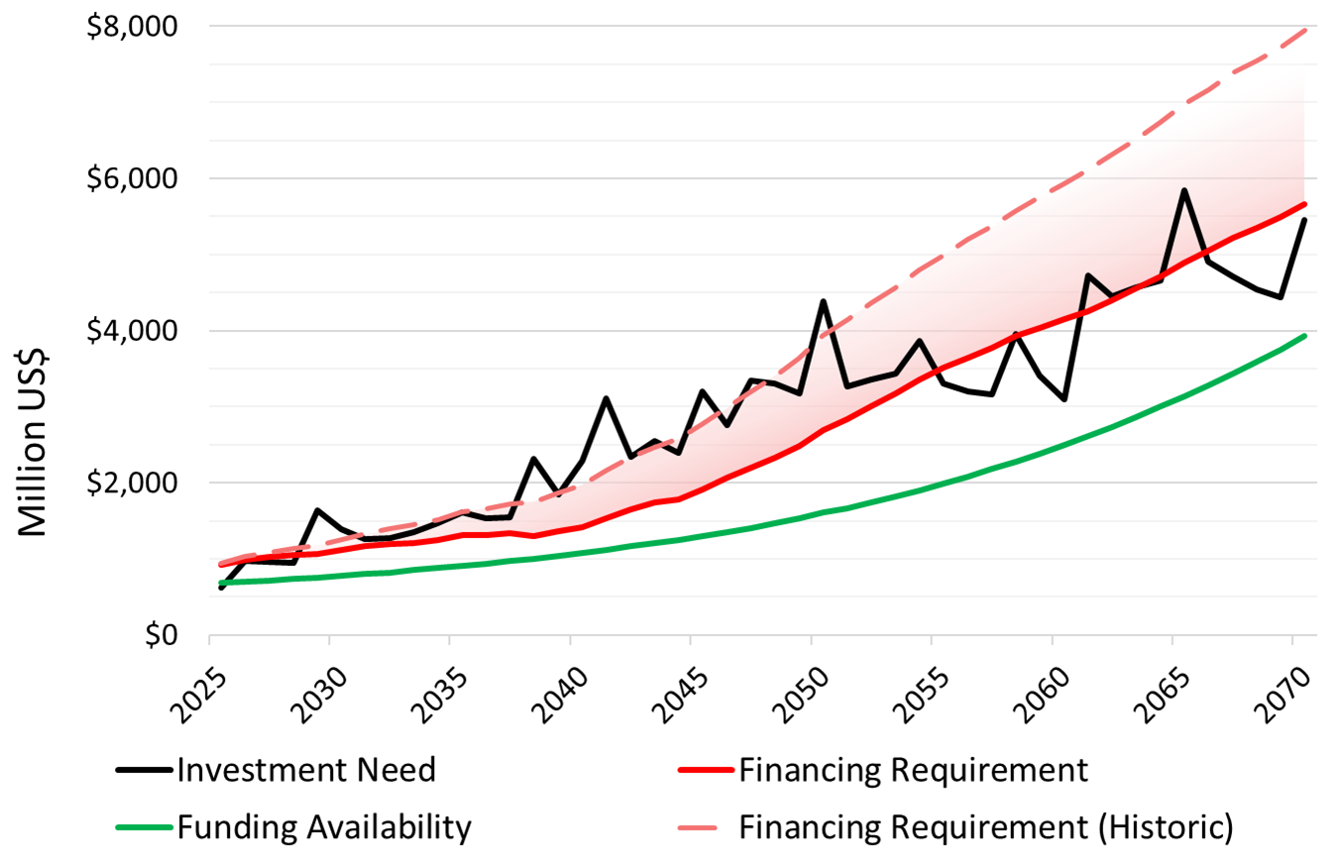
High-level dashboard with better financing terms
MINFin Projections
Simulated future
Average interest rate (%) | 3.0%
Average Grace Period (years) | 5.5
Average Loan Term (years) | 30
CAGR govt spending | -2.6%
CAGR internal cash generation | 4.6%
CAGR int’l grants | -6.1%
Notes:
Using the high-level dashboard, it is possible to explore the implications of an improvement in the financing terms available to Kenya. These are displayed in the yellow portion of the table. The average interest rate has dropped from 5.5% to just 3.0%, while the average term of loans has been extended from 25 to 20 years. The combined effect of this is to significantly reduce the financing requirement, as shown by the drop from the dotted red line to the solid red line. As a result, the financing gap is reduced throughout the transition and eliminated for the period up to 2045. Nevertheless, a financing gap persists thereafter into the later years.

Slide 22
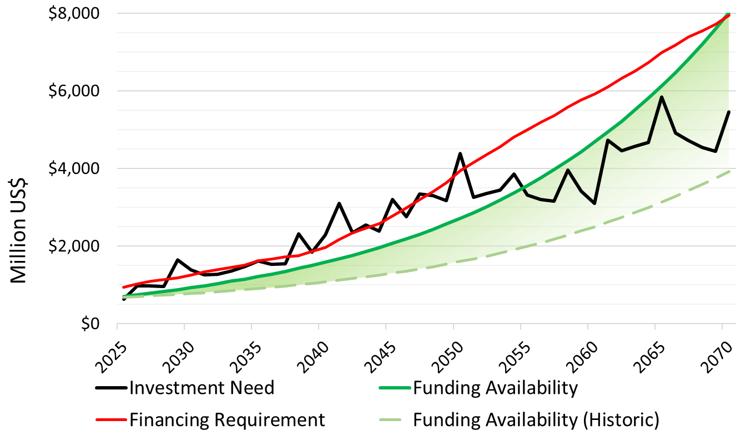
High-level dashboard with boosted funding
MINFin Projections
Simulated future
Average interest rate (%) | 5.5%
Average Grace Period (years) | 4.6
Average Loan Term (years) | 25.6
CAGR govt spending | 5.5%
CAGR internal cash generation | 5.5%
CAGR int’l grants | 5.5%
Notes:
An alternative approach to closing Kenya’s finance gap is illustrated above. In this case, the financing terms are left unchanged under business-as-usual conditions, and instead an effort is made to boost the rate of growth of the various funding sources. In particular, it is assumed that all sources of funding should be able to grow at the same rate that is forecast for Kenya’s GDP: 5.5%. This leads to substantial growth in the funding availability, reflected in a strong upwards pivot of the green line on the chart from the dotted green line to the solid green line. It turns out that this measure is enough to eliminate Kenya’s financing gap throughout the transition period.

Slide 23
Part 4: References
[1] Foster, V., Luscombe, H., Collier, W., and Fankhauser S. (2023). Data-to-Deal: How can Countries in the Global South Afford the Climate Transition?. Climate Compatible Growth Programme COP28 Policy Brief Series. Available at: https:// climatecompatiblegrowth.com/wp-content/uploads/Affordingthe-Climate-Transition.pdf.

Slide 24
Thank you
Contact Information: v.foster@imperial.ac.uk or hannah.luscombe@ouce.ox.ac.uk

